Slide 1
AI for Medical Diagnosis:
Healthcare Chatbot
VENKATESHWARA REDDY MUDIYALA

Slide 2
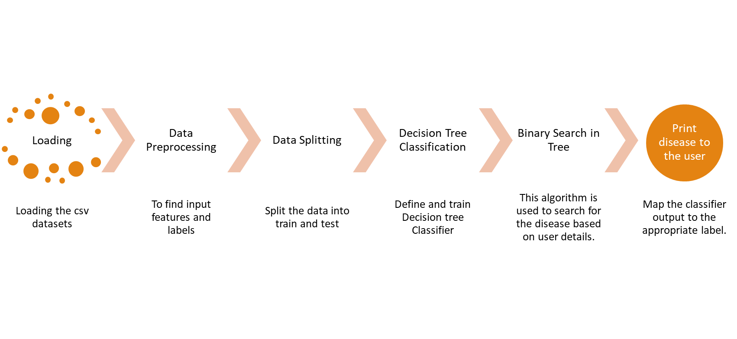
Model Overview

Slide 3
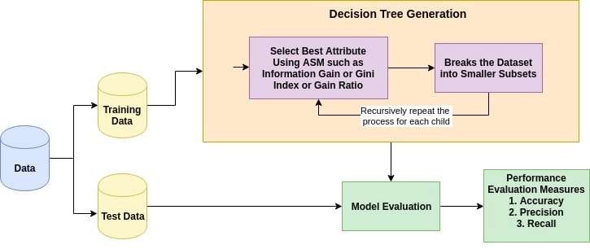
Decision trees
IMAGE SOURCE: HTTPS://RES.CLOUDINARY.COM/DYD911KMH/IMAGE/UPLOAD/F_AUTO,Q_AUTO:BEST/V1545934190/2_BTAY8N.PNG

Slide 4


Deciding Factors
Information Gain: Information gain is the decrease in entropy. Information gain computes the difference between entropy before split and average entropy after split of the dataset based on given attribute values. (entropy is randomness in the system)
Gini Index: The Gini Index considers a binary split for each attribute. You can compute a weighted sum of the impurity of each partition

Slide 5
Dataset
Training dataset : 113 features , 4920 samples
Testing dataset: 113 features, 41 samples
“prognosis” features is used as label.
Label Encoder is used to encode labels to numbers.
Before Label Encoder | After Label Encoder
Migraine | 1
Heart Attack | 2
Typhoid | 3
Acne | 4

Slide 6
Training, Testing and Cross Validation
clf1 = DecisionTreeClassifier()
clf = clf1.fit(x_train,y_train)
print(clf.score(testx,testy))
Cross-validation:
scores = cross_val_score(clf, x_test, y_test, cv=3)
Print(scores.mean())

Slide 7
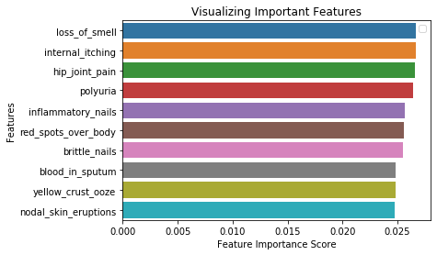
Results
Training Accuracy: 0.97
Testing Accuracy: 0.94
Important Features
IMPORTANT FEATURES OR DECIDING FACTORS FOR DECISION TREES CLASSIFIER.

Slide 8
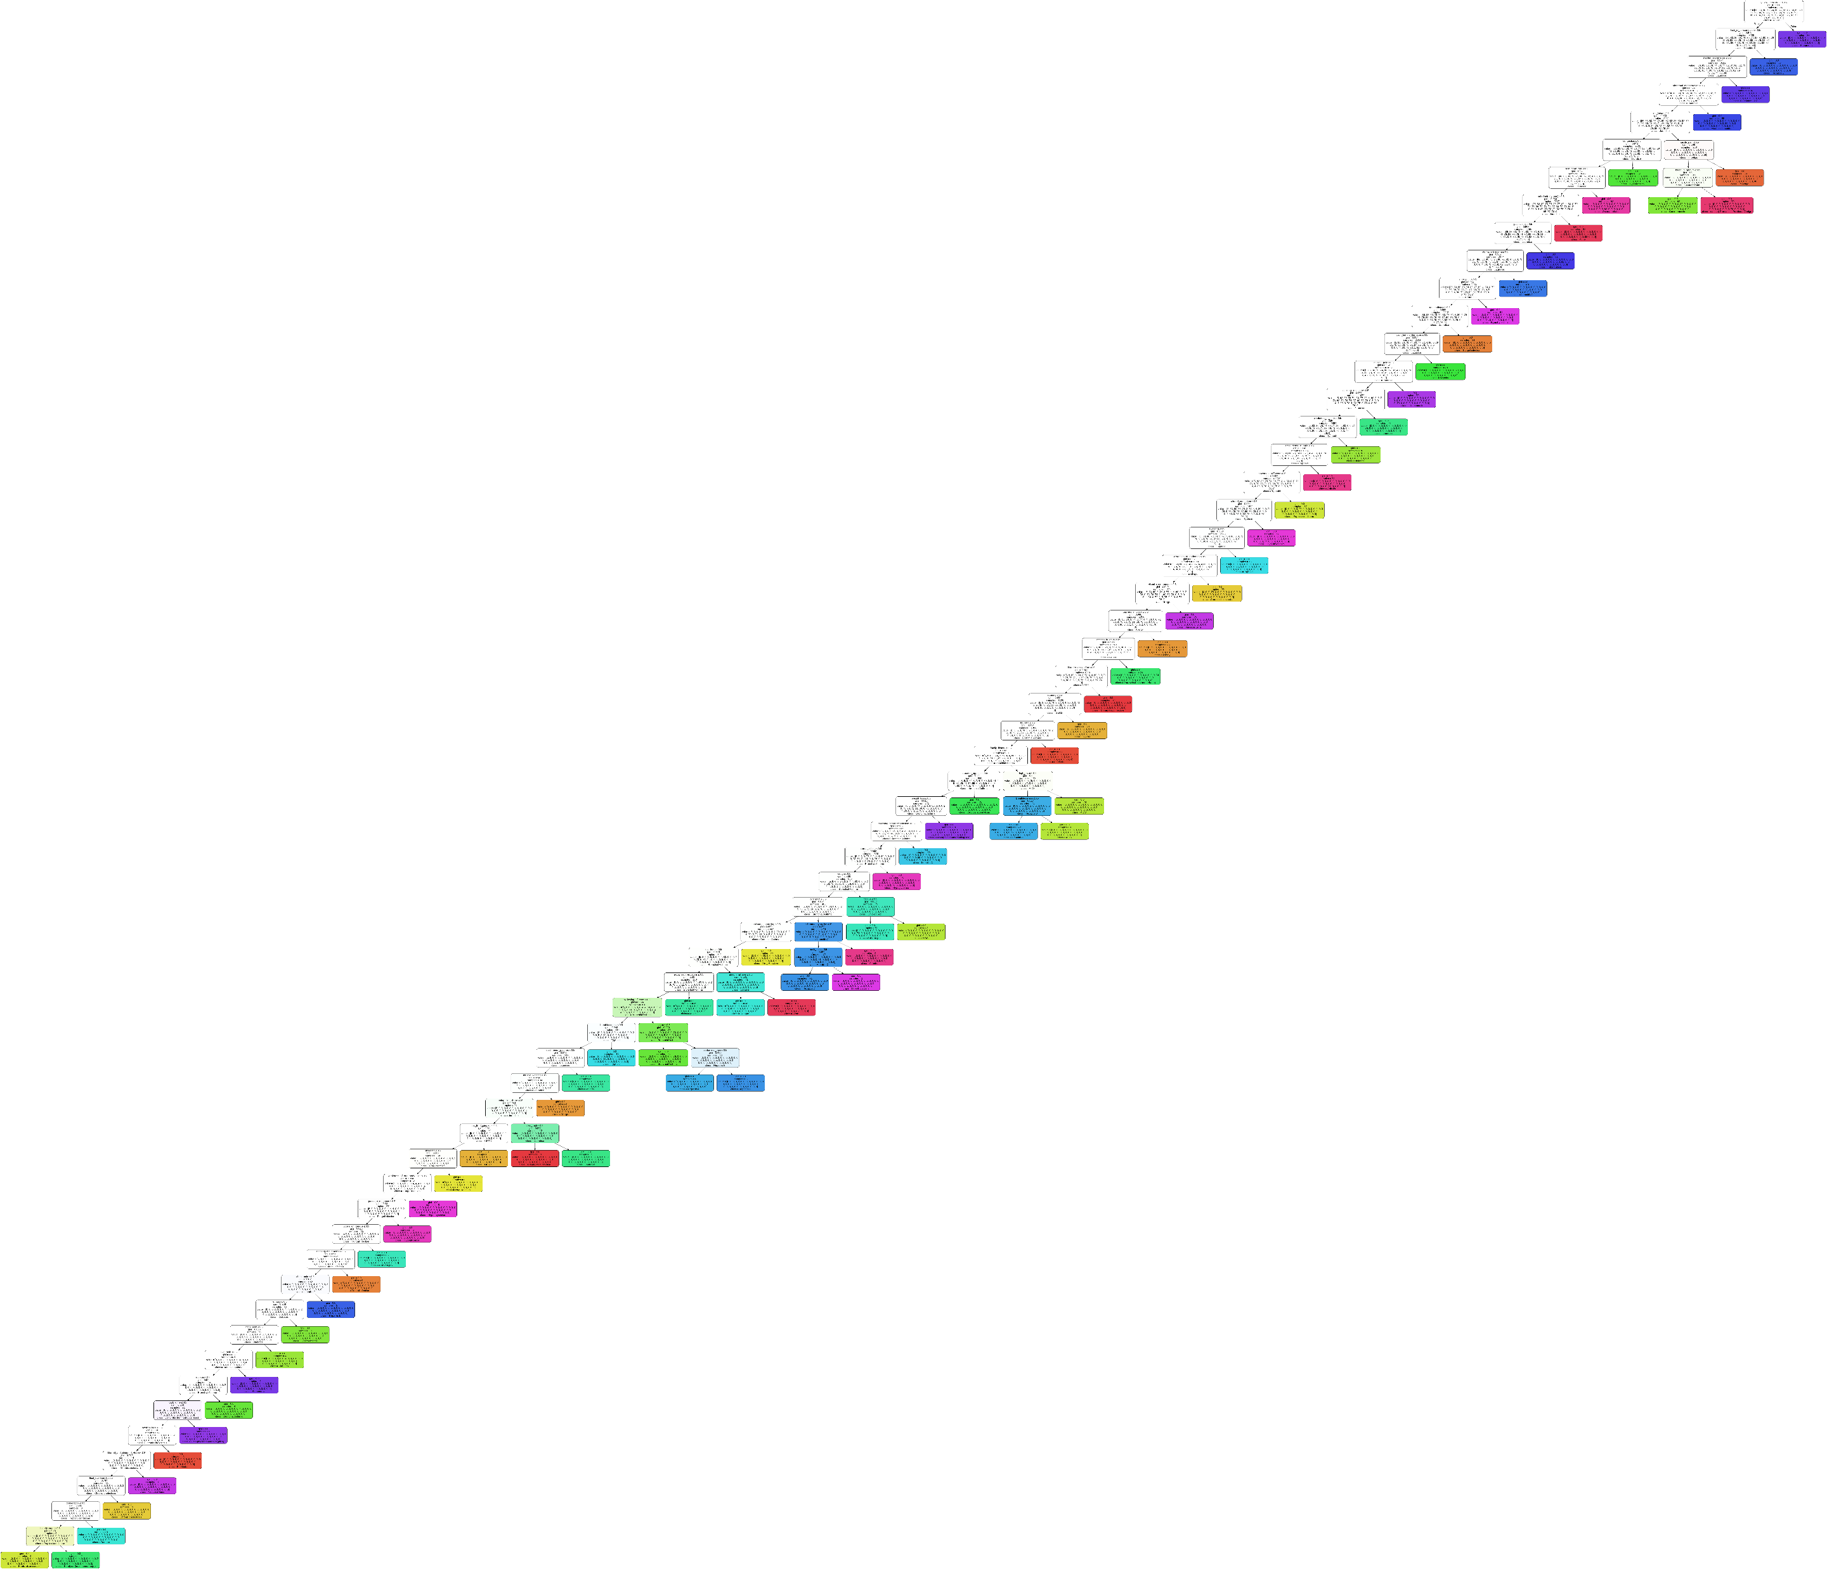
Decision tree
IMAGE GENERATED USING TRAINING DATASET AND THE DECISION TREE MODEL

Slide 9
Imp Functions (code)
Main() : Main function that gets executed when program is run
Decision_tree_bot(): Main Logic of the Decision Tree
Binary_search_in_tree(): A subfunction in Decision_tree_bot() and does binary search based on users response to the queries of the bot.
Print_disease_to_user(): This function maps the output of the decision tree to one of the diseases that the user is suffering from.

Slide 10
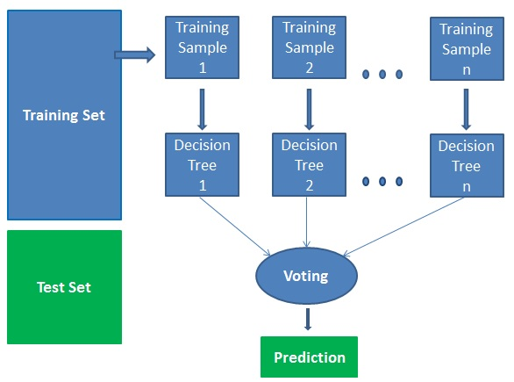
Future Improvements
Ensemble Techniques like Random Forest can be used as Decision Trees overfit noisy data. But ensemble methods need huge datasets.
IMAGE SOURCE : HTTPS://RES.CLOUDINARY.COM/DYD911KMH/IMAGE/UPLOAD/F_AUTO,Q_AUTO:BEST/V1526467744/VOTING_DNJWEQ.JPG

Slide 11
Demonstration

Slide 12
Thankyou

